Slide 1
PHYTOCHEMICAL SCREENING AND ASSESSMENT OF ANTIMICROBIAL ACTIVITY OF MIMOSA PUDICA

Slide 2
AUTHORS
Orhue Osayamen, Amengialue (Ph.D Candidate)
Lecturer at Wellspring University, NIGERIA
nuclearbrain2003@yahoo.com
Efosa Faith, Oviasogie (Ph.D)
Lecturer at University of Benin, NIGERIA
efosaoviasogie@yahoo.co.uk
May Naomi Oyairibhor, Omoigberale (Ph.D Candidate)
Lecturer at Ambrose Alli University, NIGERIA
may.oyas@yahoo.com
Basil Osahon, Omoregie (M.Sc Candidate)
University of Benin, NIGERIA
emmark_online@yahoo.com
Ruth Ebunoluwa, Bodunrinde (B.Sc)
NIGERIA
ebunoluwa_ruth@yahoo.com

Slide 3
INTRODUCTION
● While synthetic antibiotics has undoubtedly recorded significant successes in the management of diseases and infections through their static and cidal effects (but not without limitations like side effect and microbial resistance), nature as it were, has been a source of medicinal agents for thousands of years.
● Herbal medicine is based on the premise that plants contain natural substances that can promote health and alleviate illness (Balakumar and Rajan, 2011).
● Contrary to synthetic drugs, antimicrobial substances of plant origin are not associated with many side effects and have an enormous therapeutic potential to heal many infectious diseases.
● Plant extracts of many higher plants have been reported to exhibit antibacterial, antifungal and insecticidal properties under laboratory study (Satish et. al., 2007; Okigbo and Ogbonnaya, 2006.).
● With its pharmacological activities, Mimosa pudica has been reported to contain alkaloid, glycoside, flavonoid and tannis.

Slide 4
OBJECTIVE OF STUDY
This study was aimed at investigating the antimicrobial characteristics of extracts of Mimosa pudica leaves, and to screen for its phytochemical compositions responsible for its antimicrobial activity.

Slide 5
METHODOLOGY
Sample Collection and Processing:
Fresh leaves of Mimosa pudica was harvested, sun dried and pulverized into coarse particles, and then stored in a clean sterile dry container.
Test Microorganism:
Clinical isolates used were Streptococcus pyogenes, Staphylococcus aureus, Bacillus subtilis, Escherichia coli, Klebsiella pneumonia, Pseudomonas aeruginosa, Candida albican, Penicillun notatum and Aspergillus niger.
Standardisation Of The Test Organisms:
Each test organisms were sub-cultured with nutrient broth and its turbidity compared with that of 0.5 Mac‐Farland to standardize each culture to 10⁶cfu/ml.
Preparation Of Plant Extracts:
Aqueous, ethanol, and methanol extraction of Mimosa pudica leavewere made and concentrated to paste-like form using the steam bath at 60⁰C.
Reconstitution Of Extracts:
Extracts were reconstituted using distilled water to obtain 100mg/ml, 50 mg/ml, 25 mg/ml, 12.5 mg/ml, and 6.25 mg/ml concentrations and stored at 4ºC in sample bottles until required.

Slide 6
Antimicrobial Activity:
Antimicrobial activity was performed to evaluate the antimicrobial properties of each extracts employing the agar well diffusion method as described by Ahmad and Beg, (2001).
Minimum Inhibitory Concentration (MIC):
The broth dilution method as earlier described by Bailey and Evelyn (1970) was employed in the determination of the minimum inhibitory concentration (MIC) of each extracts.
Minimum Bactericidal/Fungicidal Concentration (MBC and MFC)
The bactericidal and fungicidal concentrations of the extracts were determined with the absence of growth of bacteria and fungi colonies on plates after incubation.
Phytochemical Analysis:
Qualitative screening of the crude sample/extracts were carried out to determine the presence of the following phytochemicals: alkaloid, steroids, tannins, glycosides, saponins and flavonoids.

Slide 7
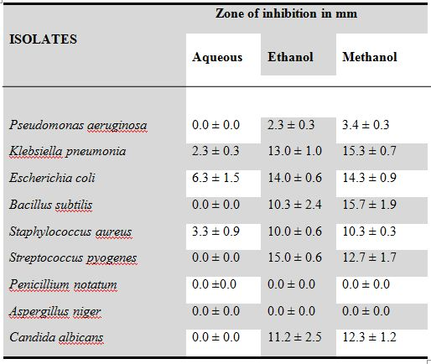
RESULTS
Table 1: Antimicrobial Activity Of Plant Extracts At 100mg/ml Concentration

Slide 8
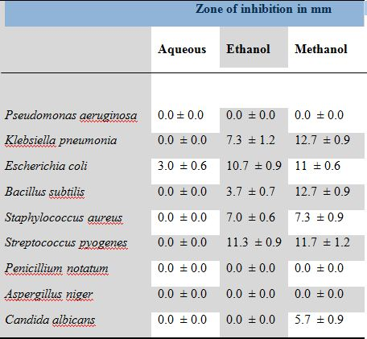
Table 2: Antimicrobial Activity Of Plant Extracts At 50mg/ml Concentration

Slide 9
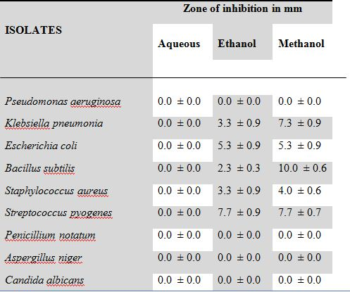
Table 3: Antimicrobial Activity Of Plant Extracts At 25mg/ml Concentration

Slide 10
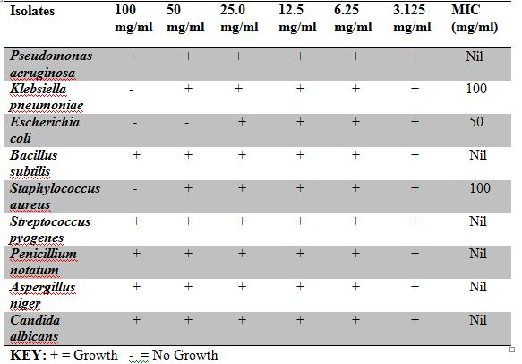
Table 4: Minimum Inhibitory Concentration Of Aqueous Extract In mg/ml

Slide 11
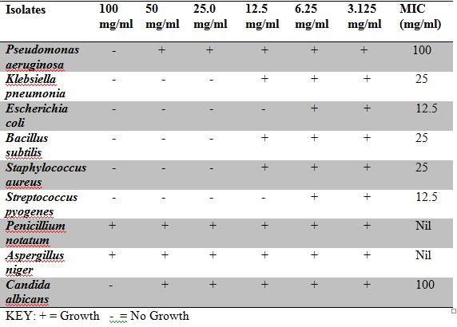
Table 5: Minimum Inhibitory Concentration Of Ethanol Extract In mg/ml

Slide 12
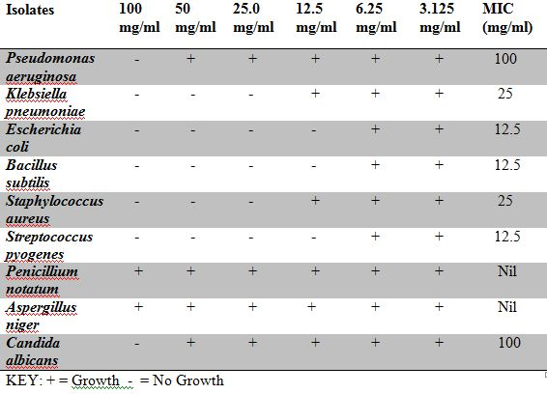
Table 6: Minimum Inhibitory Concentration Of Methanol Extract In mg/ml

Slide 13
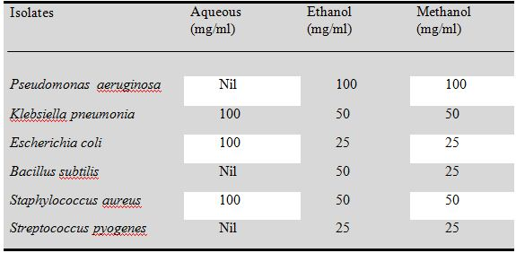
Table 7: Minimum Bactericidal Concentration For Aqueous, Ethanol And Methanol extracts

Slide 14
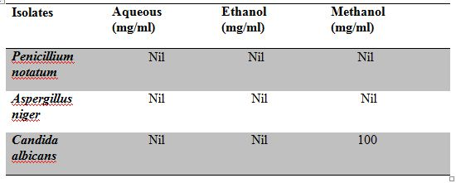
Table 8: Minimum Fungicidal Concentration For Aqueous, Ethanol And Methanol Extracts

Slide 15
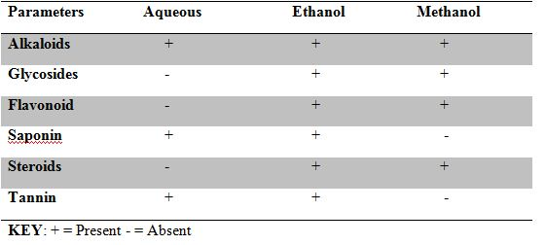
Table 9: Qualitative Phytochemical Composition Of Plant Extract

Slide 16
SUMMARY RESEARCH FINDINGS
Results of this research revealed the following findings:
1.Extract of Mimosa pudica is a promising medicinal plant source for the treatment of gram positive and gram negative bacterial infections
2. Extract of Mimosa pudica as a medicinal plant source, has a better and more efficient use as antibacterial agent over being an antifungal agent.
3. Qualitative phytochemical screening of Mimosa pudica revealed its bioactive phytochemical constituents to be alkaloids, flavonoid, glycosides, steroids, saponin and tannin.
4. Methanol is a better and more efficient solvent extractor of the bioactive phytochemical constituents of Mimosa pudica.

Slide 17
CONCLUSION
While it has been widely observed and accepted that the medicinal value of plants lies in the bioactive phytochemicals present in plants (Veermuthu et. al., 2006), this research study has brought to knowledge, the promising benefits of exploring Mimosa pudica for its antibacterial potentials and other medicinal values.

Slide 18
THANK YOU

