Slide 1
YOUNG LEARNERS` LANGUAGE ACQUISITION AND USE OF APPROPRIATE METHODS
Khulkar Normuminova
Uzbekistan State World Languages University
UZBEKISTAN

Slide 2
Challenges of teaching English for Uzbek young learners and traditional approaches
Similarities of Uzbek and English letter spelling
Confusable sounds

Slide 3
Research
Age-and-acquisition-inspired teaching methods
Total Physical Response
Natural Approach
Age–and-acquisition-inspired teaching methods

Slide 4
Natural Approach
Krashen:”…They should be given opportunity to “pick up” a language, they should not be forced to “study” grammar in the classroom

Slide 5
Total Physical Response
J.Asher:”…in learning their first language, appear to do a lot of listening before they speak, and that their listening is accompanied by physical responses(reaching, grabbing, moving, looking, and so forth)

Slide 6
Practice
Use of TPR and Natural Approach in the classroom
Dealing with difficulties and work on common pronunciation mistakes which were made by the learner during the lesson while performing language
Using TPR and Natural Approach

Slide 7
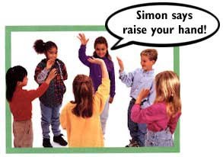
TPR method
“Listen and do” activities
“Simon says” activity
Identifying Tenses while listening and imitating actions

Slide 8
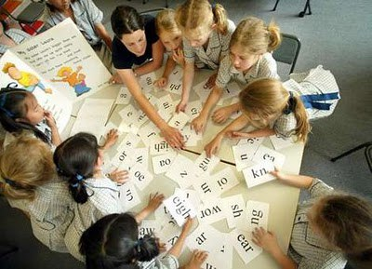
Natural Approach
Use of real objects, pictures, visual aids, slides in order to introduce theme
Working with worksheets and project works

Slide 9
Findings
Source of collected data
Difficulties encountered while utilizing Age-and-acquisition-inspired Methods
Benefits to the learner`s Language Acquisition

Slide 10
Conclusion
Findings from the research
Dealing with encountered problems
Learners` opinions about the appropriate methods English Language learning process

Slide 11
References
Douglas Brown (2016. 6th edition) Principles of Language Learning and Teaching (pp. 73-75)
Stephen D Krashen (1982) Principles and practice in Second Language Acquisition (pp.137-141)
Stephen D Krashen, Trace D Terrell (1995) The Natural Approach Language Acquisition in the classroom (pp.57-59)
David Birdsong (2009) Age and state of second language acquisition (http://scholar.google.com)
http://goo.gl/images/eUhoHb
http://goo.gl.images/pCX3F6

